Slide 1
Insulin Calculator: Secret steps to invoke
14-step process
3 Value-added steps
3 safety checks: 2 flawed

Slide 2
Old Insulin Calculator output

Slide 3
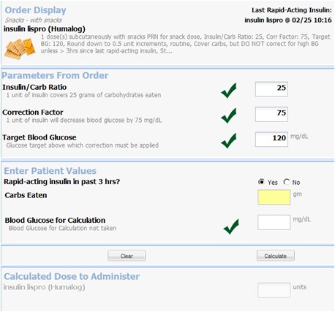
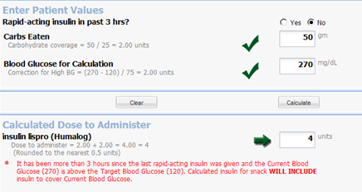
Improved/Integrated Insulin Calculator
8-step process
2 Value-added steps
6 safety checks
Upstream mistake-proofing

Slide 4
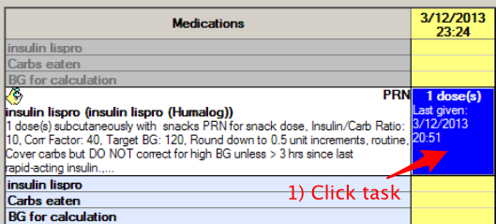
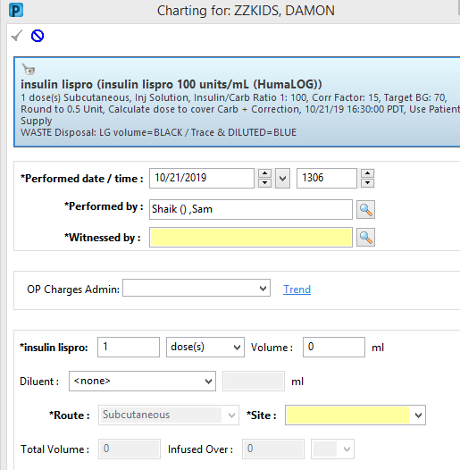
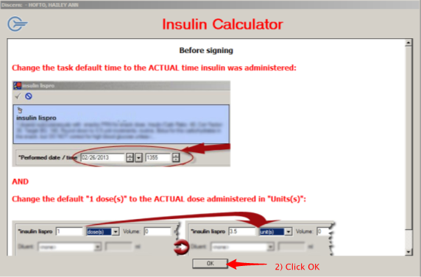

Slide 5
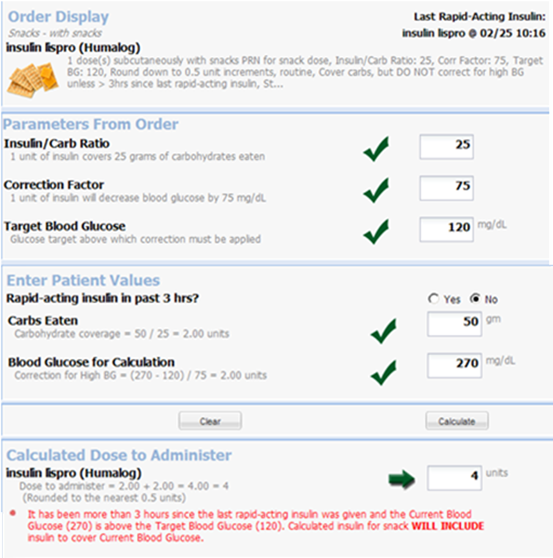
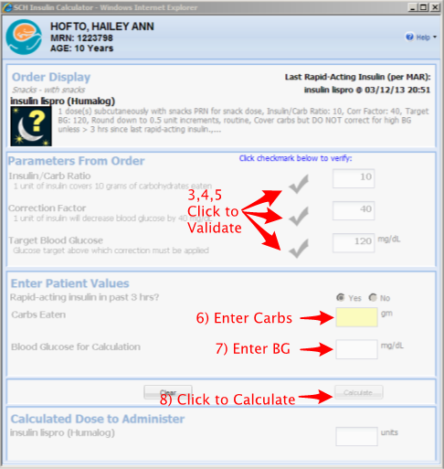

Slide 6
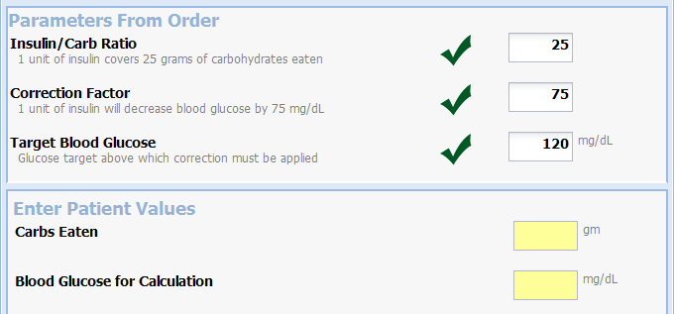
Parameters pulled from order
Prevents transcription error
Grey dithered check changes to green check
Serves as active validation of ordered parameters
Required data entry fields yellow

Slide 7
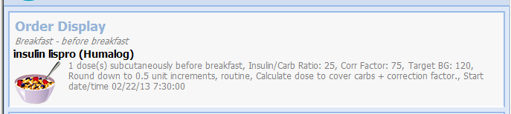
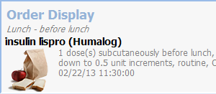
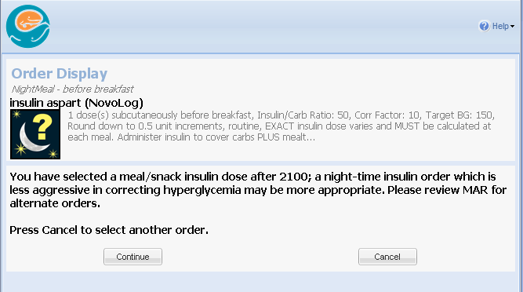
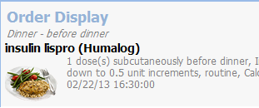
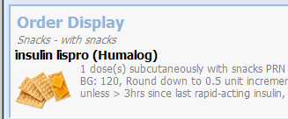
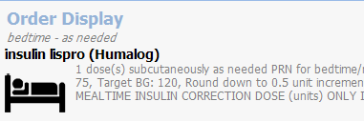
Correct Order Identification: Visual cues

Slide 8





Carbohydrate Validation and Feedback
“0” Carbs is acceptable at any time
Calculation is displayed
Data entry validation
Carbs > 250 gm are challenged
Carbs > 300 gm are not valid

Slide 9
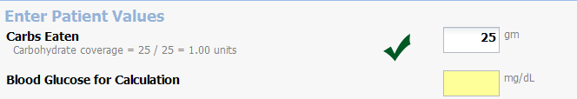
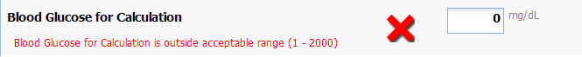
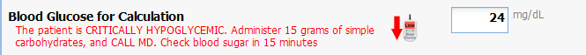
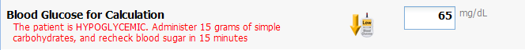
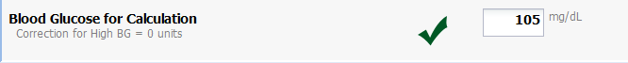
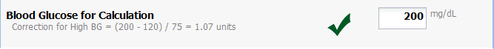
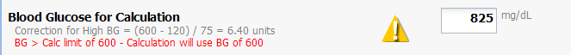
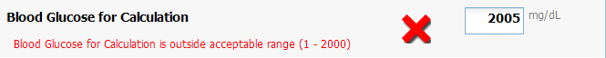
Blood Glucose for Calculation Validation and Feedback

